Slide 1


Signals & Systems For Computer Engineering
Prof.Dr. B.Berk ÜSTÜNDAĞ
Istanbul Technical University
Faculty of Computer Engineering and Informatics
BLG354E / CRN: 21615
6th Week Lecture (cont.)
2020
bustundag@itu.edu.tr
BLG354E / CRN: 21560
8th Week Lecture

Slide 2
Frequency response of the systems
Transfer function of an LTI sytem
Steady state response of a system H(s) can be found as H(jω) by s= jω
Magnitude response of the system:
Phase response of the system:
BLG354E - İTÜ Faculty of Computer Engineering and Informatics - Üstündağ

Slide 3
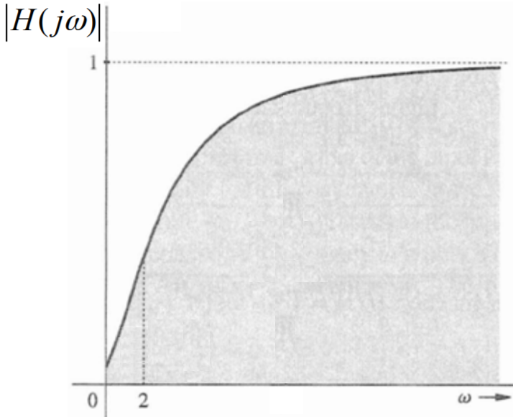
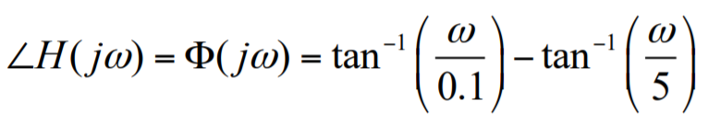



Example:
Find the frequency response of the system
H(s)$=\frac{s+0.1}{s+5}$
and its output y(t) for input x(t)=cos2t
When we substitute s= $\text{j}ω$
→
H(j$ω$)$=\frac{\text{j}ω+0.1}{\text{j}ω+5}$
Magnitude response:
0.372
65.3°
Phase response:
BLG354E - İTÜ Faculty of Computer Engineering and Informatics - Üstündağ

Slide 4
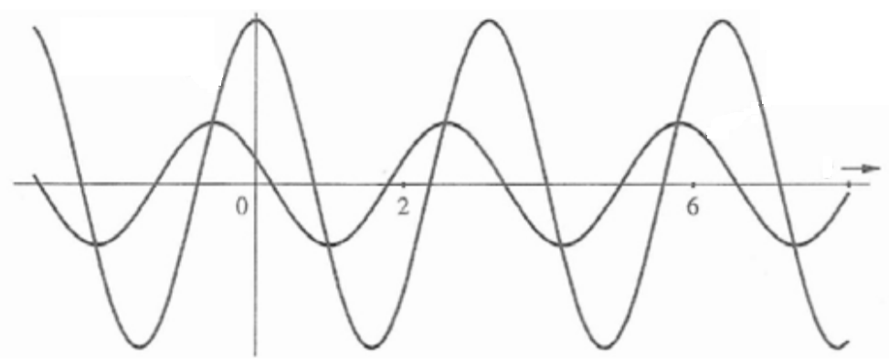
for input x(t)=cos2t
Amplitude:
Phase:
ϴ(j2)=
Output:
y(t)=0.372cos(2t+65.3°)
y(t)=cos(2t)
y(t)=0.372cos(2t+65.3°)
BLG354E - İTÜ Faculty of Computer Engineering and Informatics - Üstündağ

Slide 5
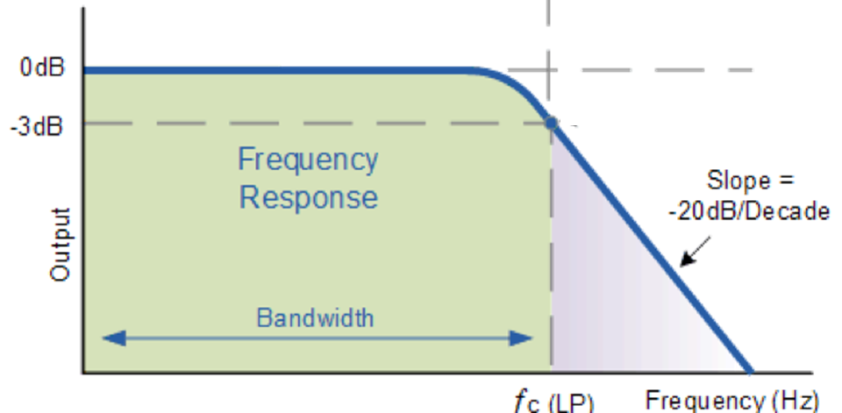
Bandwidth of a 1st order low pass system
asymptote
|H(ω)|
Pass Band
Stop Band
ω_{BW}
ω (rad/s)
f(Hz)
ω_{c}
BLG354E - İTÜ Faculty of Computer Engineering and Informatics - Üstündağ

Slide 6
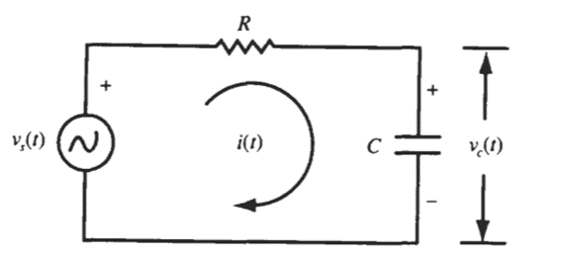

Example:
Find the frequency response R=10kΩ, C=1µF
x(t)
R
v_{c}
y(t)
i_{c}
C
0
0
v_{c}(t)
v_{s}(t)
X(s)
$$\frac{1}{τs+1}$$
Y(s)
τ=RC=1/ω₀
BLG354E - İTÜ Faculty of Computer Engineering and Informatics - Üstündağ

Slide 7
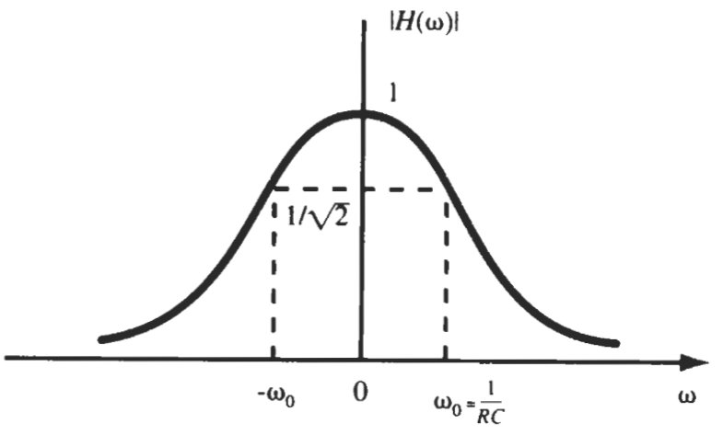
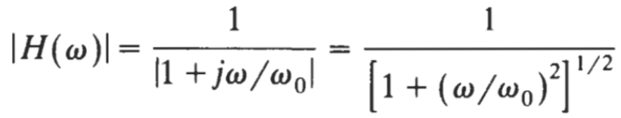


Bandwidth:
$$20log\frac{U_{2}}{U_{1}}=−3dB$$
→
$$\frac{U_{2}}{U_{1}}={10}^{\frac{−3}{20}}=0.707=\frac{1}{\sqrt{2}}$$
BLG354E - İTÜ Faculty of Computer Engineering and Informatics - Üstündağ

Slide 8
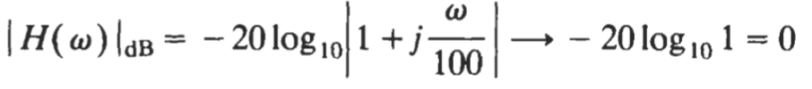
Magnitude response of the RC Low Pass Filter:
Phase response of the RC Low Pass Filter:
For ω≪100 :
as ω→0
For ω≫100 :
as ω→∞
BLG354E - İTÜ Faculty of Computer Engineering and Informatics - Üstündağ

Slide 9
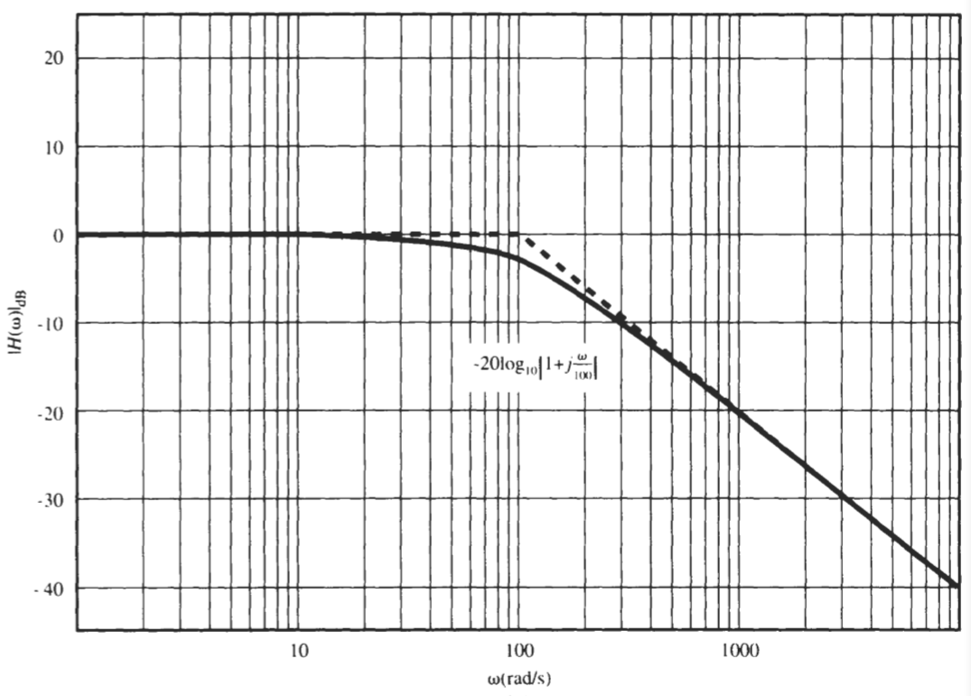

X(s)
$$\frac{1}{0.01s+1}$$
Y(s)
BLG354E - İTÜ Faculty of Computer Engineering and Informatics - Üstündağ

Slide 10
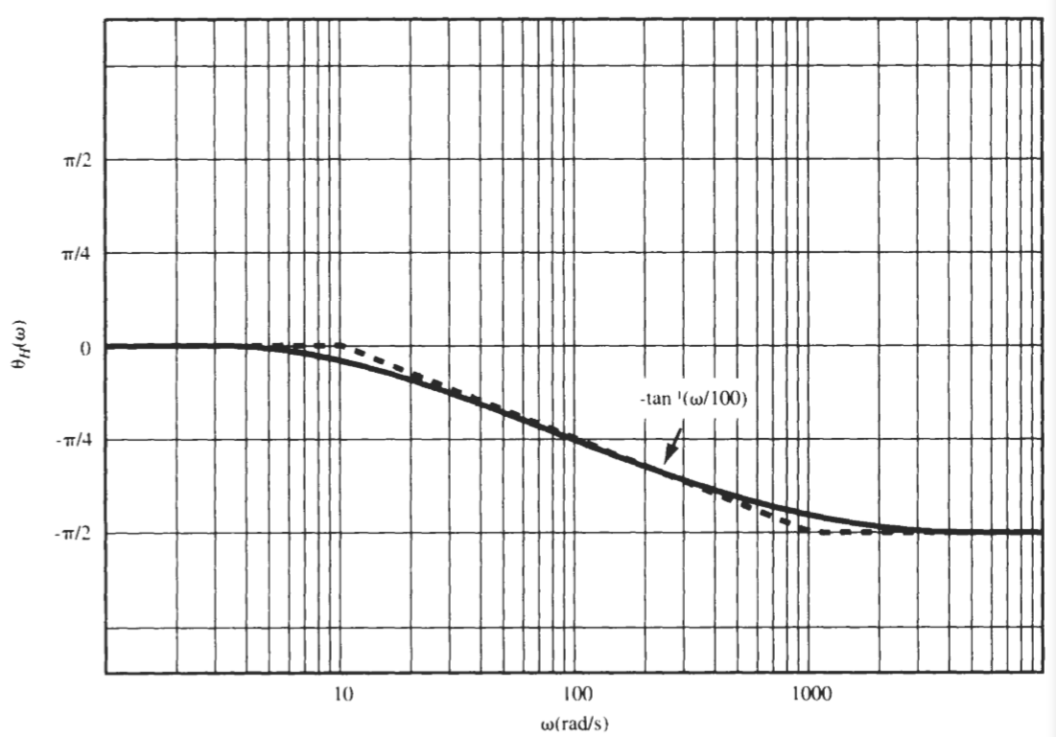

X(s)
$$\frac{1}{0.01s+1}$$
Y(s)
BLG354E - İTÜ Faculty of Computer Engineering and Informatics - Üstündağ

Slide 11
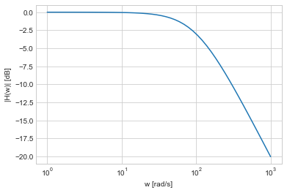
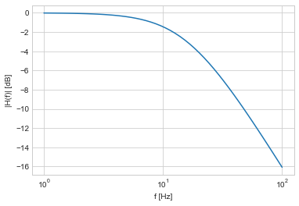
from pylab import *
def H(w):
wc = 100
G = 1.0 / (1.0 + 1j * w / wc)
return G
w = logspace(0,3) # frequencies from 10**0 to 10**3
xscale('log')
ylabel('|H(w)| [dB]')
xlabel('w [rad/s]')
plot(w, 20*log10(abs(H(w))))
from pylab import *
def H(f):
fc = 100/(2*pi)
G = 1.0 / (1.0 + 1j * f / fc)
return G
f = logspace(0,2) # frequencies from 10**-1 to 10**2
xscale('log')
ylabel('|H(f)| [dB]')
xlabel('f [Hz]')
plot(f, 20*log10(abs(H(f))))
BLG354E - İTÜ Faculty of Computer Engineering and Informatics - Üstündağ

Slide 12


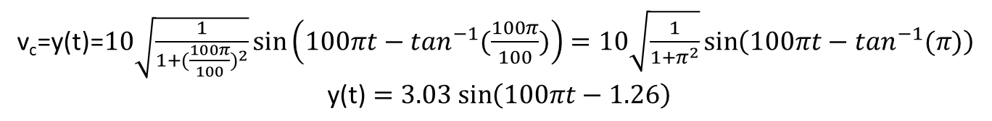

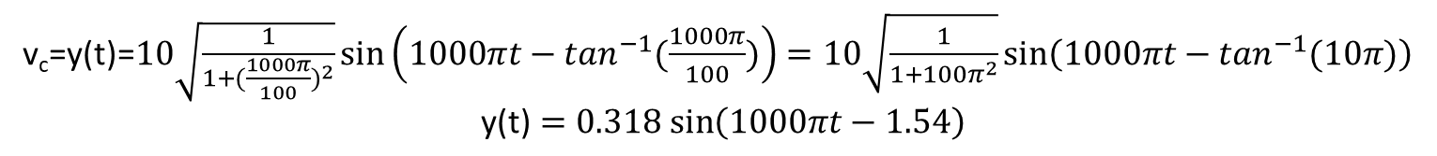
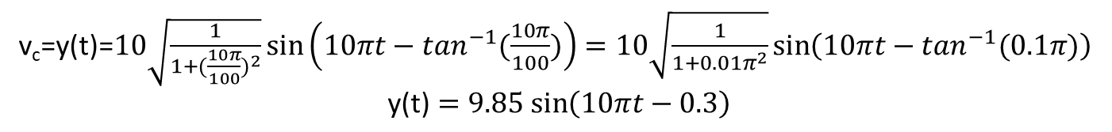
X(s)
$$\frac{1}{0.01s+1}$$
Y(s)
a) If v_{s}=x(t)=10sin(100πt)
→ ω=100π rad/s, f=50Hz
v_{c}=y(t)=$10\sqrt{\frac{1}{1+{(\frac{100π}{100})}^{2}}}\sin\left(100πt−\tan^{−1}(\frac{100π}{100})\right)=10\sqrt{\frac{1}{1+π^{2}}}sin\left(100πt−\tan^{−1}(π)\right)$
$$\text{y}\text{(}\text{t}\text{)}=3.03 sin\left(100πt−1.26\right)$$
-72.3°
b) If v_{s}=x(t)=10sin(10πt)
→ ω=10π rad/s, f=5Hz
v_{c}=y(t)=$10\sqrt{\frac{1}{1+{(\frac{10π}{100})}^{2}}}\sin\left(10πt−\tan^{−1}(\frac{10π}{100})\right)=10\sqrt{\frac{1}{1+{0.01π}^{2}}}sin\left(10πt−\tan^{−1}(0.1π)\right)$
$$\text{y}\text{(}\text{t}\text{)}=9.85 sin\left(10πt−0.3\right)$$
-17.4°
c) If v_{s}=x(t)=10sin(1000πt)
→ ω=1000π rad/s, f=500Hz
v_{c}=y(t)=$10\sqrt{\frac{1}{1+{(\frac{1000π}{100})}^{2}}}\sin\left(1000πt−\tan^{−1}(\frac{1000π}{100})\right)=10\sqrt{\frac{1}{1+{100π}^{2}}}sin\left(1000πt−\tan^{−1}(10π)\right)$
$$\text{y}\text{(}\text{t}\text{)}=0.318 sin\left(1000πt−1.54\right)$$
$$20log\frac{U_{2}}{U_{1}}=−30dB$$
→
$\frac{U_{2}}{U_{1}}={10}^{\frac{−30}{20}}=0.$0316
x10
-88.2°
BLG354E - İTÜ Faculty of Computer Engineering and Informatics - Üstündağ

Slide 13
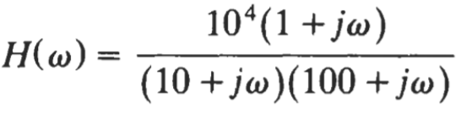
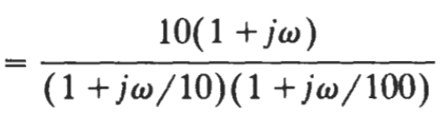

Example:
Transfer function of a system is
$$H\left(s\right)=\frac{{10}^{4}(s+1)}{(s+10)(s+100)}$$
. Find the frequency response of this system
Corner frequencies: ω=1, ω=10, ω=1 , ω=100
For ω=1 →
For ω=10 →
For ω=100 →
BLG354E - İTÜ Faculty of Computer Engineering and Informatics - Üstündağ

Slide 14
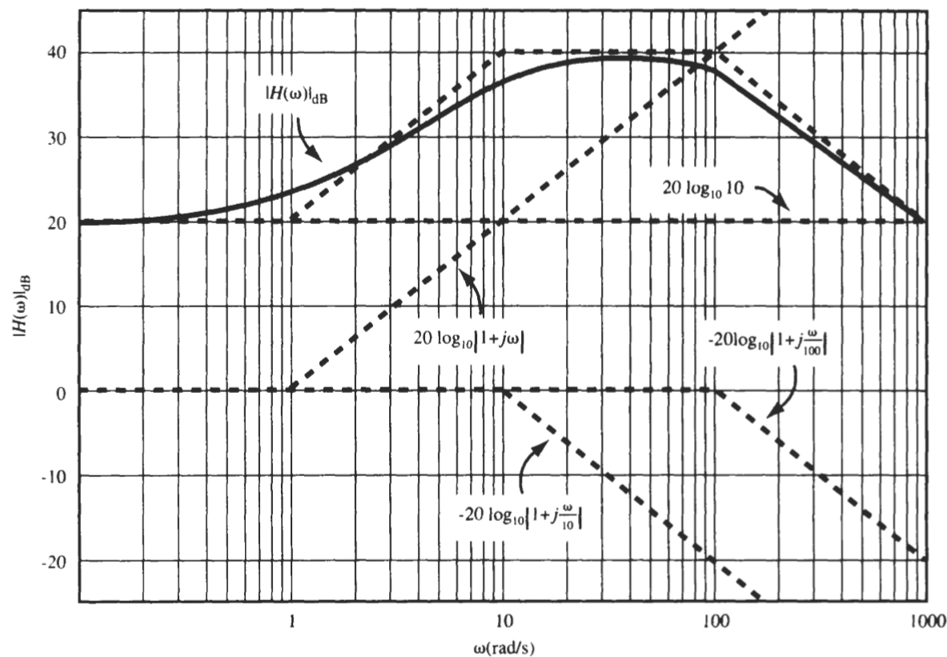
BLG354E - İTÜ Faculty of Computer Engineering and Informatics - Üstündağ

Slide 15


For ω → 0 :
For ω → ∞ :
For ω=1 →
For ω=10 →
For ω=100 →
BLG354E - İTÜ Faculty of Computer Engineering and Informatics - Üstündağ

Slide 16
BLG354E - İTÜ Faculty of Computer Engineering and Informatics - Üstündağ

Slide 17
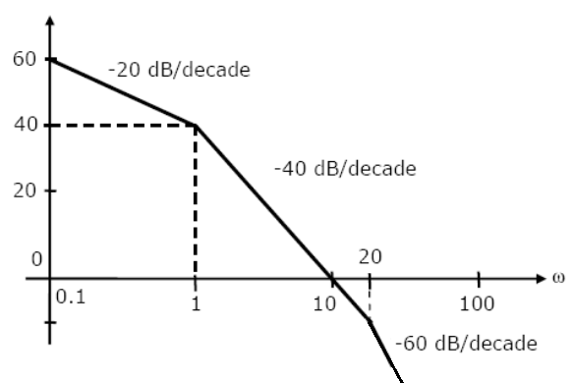

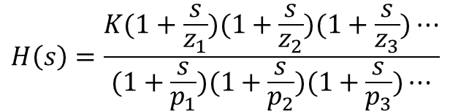

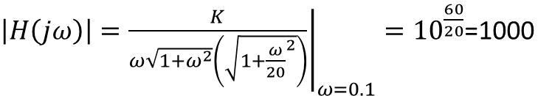
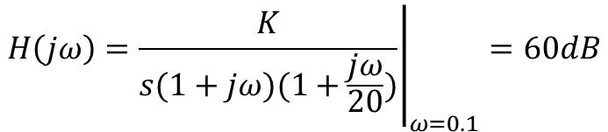

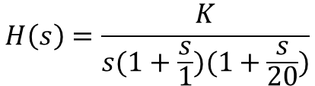
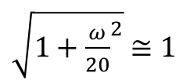
Example:
Magnitude response of H(s) is given in the below Bode plot. Find the transfer function H(s)
M(ω)
$$H\left(s\right)=\frac{K(1+\frac{s}{z_{1}})(1+\frac{s}{z_{2}})(1+\frac{s}{z_{3}})⋯}{(1+\frac{s}{p_{1}})(1+\frac{s}{p_{2}})(1+\frac{s}{p_{3}})⋯}$$
20log|H(ω)|
$$H\left(s\right)=\frac{K}{s(1+\frac{s}{1})(1+\frac{s}{20})}$$
$$H\left(jω\right)={\left.\frac{K}{s(1+jω)(1+\frac{jω}{20})}\right|}_{ω=0.1}=60dB$$
0
$\left|H\left(jω\right)\right|={\left.\frac{K}{ω\sqrt{1+ω^{2}}\left(\sqrt{1+{\frac{ω}{20}}^{2}}\right)}\right|}_{ω=0.1}={10}^{\frac{60}{20}}$=1000
$\sqrt{1+ω^{2}}$ $≅1$
$\sqrt{1+{\frac{ω}{20}}^{2}}$ $≅1$
$\frac{K}{ω}=\frac{K}{0.1}≅$1000
→ K=100
For ω=0.1 →
$$H\left(s\right)=\frac{100}{s(1+s)(1+0.05s)}$$

Slide 18

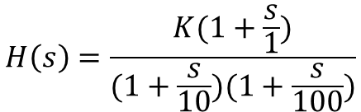

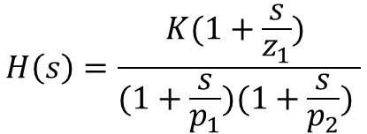


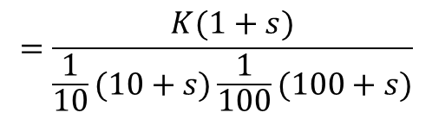
Example:
Frequency response (magnitude) of H(s) is given in the below Bode plot. Find the transfer function H(s)
M(ω)
$$H\left(s\right)=\frac{K(1+\frac{s}{z_{1}}) }{(1+\frac{s}{p_{1}})(1+\frac{s}{p_{2}}) }$$
20log|H(ω)|
0dB
+20dB/dec
-20dB/dec
$$H\left(s\right)=\frac{K(1+\frac{s}{1})}{(1+\frac{s}{10})(1+\frac{s}{100})}$$
$$=\frac{K(1+s)}{\frac{1}{10}(10+s)\frac{1}{100}(100+s)}$$
-20dB
0
1
10
100
ω(rad/s)
$$H\left(s\right)=\frac{1000K(1+s)}{(10+s)(100+s)}$$
$$H\left(jω\right)=\frac{1000K(1+jω)}{(10+jω)(100+jω)}$$
For ω=0 →
20log|H(ω)|)=-20
→
${\left|H\left(jω\right)\right|}_{ω=0}$= $\frac{1000K}{10∙100}={10}^{\frac{−20}{20}}=0.1$
→
K=0.1
$$H\left(s\right)=\frac{100(1+s)}{(10+s)(100+s)}$$
BLG354E - İTÜ Faculty of Computer Engineering and Informatics - Üstündağ

Slide 19


import numpy
import matplotlib.pyplot as plt
from ipywidgets import interact
omega = numpy.logspace(-1, 3, 1000); s = 1j*omega
def annotated_bode(ax_gain, ax_phase, H, K, tau, order):
high_freq_asymptote = K/(tau*omega)**order
# Gain part
ax_gain.loglog(omega, numpy.abs(H))
ax_gain.axhline(K, color='grey', linestyle=':')
ax_gain.loglog(omega, high_freq_asymptote, color='grey',linestyle='--')
ax_gain.axvline(1/tau, color='grey',linestyle=':')
ax_gain.set_ylim([1e-2, 1e+2])
ax_gain.set_ylabel('|H(w)|')
# Phase part
ax_phase.axhline(0, color='grey', linestyle='--')
ax_phase.semilogx(omega, numpy.unwrap(numpy.angle(H)))
ax_phase.axhline(-numpy.pi/2*order, color='grey',linestyle='--')
ax_phase.axvline(1/tau, color='grey',linestyle=':')
ax_phase.set_ylim([-3*numpy.pi/2, 2*numpy.pi/2])
ax_phase.set_ylabel(r'$\angle H(w)$')
def plotresponse(order, tau, K):
H = K/(tau*s + 1)**order
fig, [ax_gain, ax_phase] = plt.subplots(2, 1)
annotated_bode(ax_gain, ax_phase, H, K, tau, order)
interact(plotresponse, order=2, tau=0.1, K=10)
Bode Plot Application by Python:
H(jω)
$$H\left(s\right)=\frac{K}{{(τs+1)}^{n}}$$
$$H\left(jω\right)=\frac{K}{{(τjω+1)}^{n}}$$
BLG354E - İTÜ Faculty of Computer Engineering and Informatics - Üstündağ

Slide 20
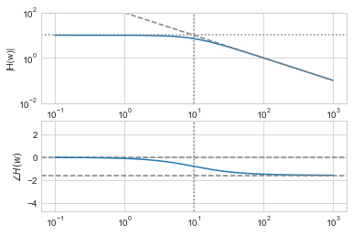

n=1, K=10, τ=0.1
$$H\left(s\right)=\frac{1}{0.1s+1}$$
Δy/Δx =-20dB/dec
BLG354E - İTÜ Faculty of Computer Engineering and Informatics - Üstündağ

Slide 21
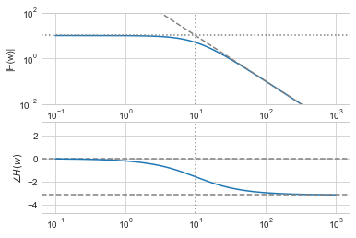

n=2, K=10, τ=0.1
$$H\left(s\right)=\frac{10}{{\left(0.1s+1\right)}^{2}}$$
Δy/Δx=-40dB/dec
BLG354E - İTÜ Faculty of Computer Engineering and Informatics - Üstündağ

Slide 22
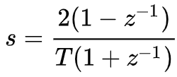
Bilinear transformation
If a transfer function is known in s domain then its discrete equivalent can be found in z domain. It can also be converted into difference equations for a specified sampling time T . Therefore it can be used for real time code implementation
Inverse bilinear transformation can be used finding the frequency response of discrete time LTI systems
BLG354E - İTÜ Faculty of Computer Engineering and Informatics - Üstündağ

Slide 23
Response to Weighted Sum of Two Sinusoids
Assume that an LTI system transfer function is H(s) and its frequency response is expressed in terms of its magnitude response |H(ω)| and the phase response ϴ_{H}(ω) (its also denoted as ∠H(ω) ). If a signal x(t) consisting of two sinusoidal components is applied to the system then output of the system y(t) can be determined by superposition of the frequency responses for each sinusoidal input signal component.
x(t)=A₁ sin(ω₁t+ ϴ₁)+A₂ sin(ω₂t+ ϴ₂)
y(t)=A₁ |H(ω₁)| sin(ω₁t+ϴ₁+ϴ_{H}(ω₁))+A₂ |H(ω₂)| sin(ω₂t+ ϴ₂+ϴ_{H}(ω₁))
This property is valid for discrete time systems too:
X[n]=A₁ sin(Ω₁n+ ϴ₁)+A₂ sin(Ω₂n + ϴ₂)
y[n]=A₁ |H(Ω₁)| sin(Ω₁n+ϴ₁+ϴ_{H}(Ω₁)) + A₂ |H(Ω₂)| sin(Ω₂n+ϴ₂+ϴ_{H}(Ω₂))
How can we find the frequency response if the input signal x(t) is not sinusoidal ?
BLG354E - İTÜ Faculty of Computer Engineering and Informatics - Üstündağ

Slide 24
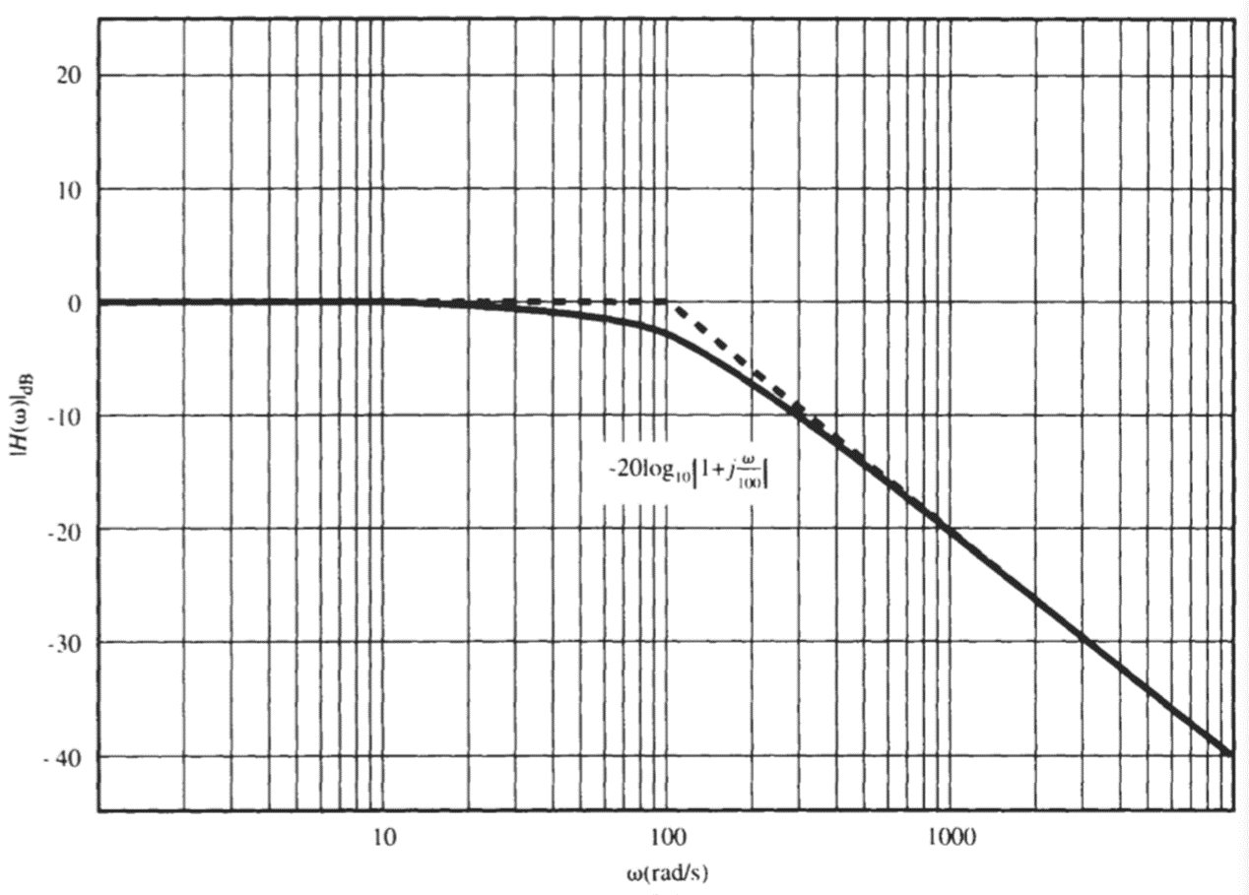
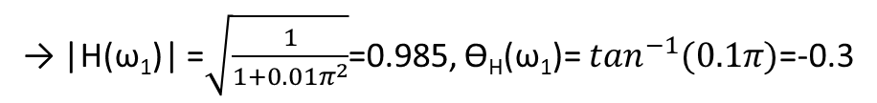


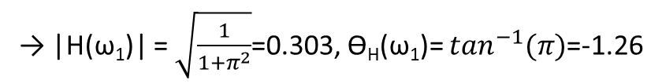





Example:
X(s)
$$\frac{1}{0.01s+1}$$
Y(s)
x(t)= 5sin(100πt+π/6) +10sin($10πt$)
y(t)= ?
$$U_{1}$$
$$U_{2}$$
y(t)=A₁ |H(ω₁)| sin(ω₁t+ϴ₁+ϴ_{H}(ω₁))+A₂ |H(ω₂)| sin(ω₂t+ ϴ₂+ϴ_{H}(ω₁))
→ |H(ω₁)| = $\sqrt{\frac{1}{1+π^{2}}}$=0.303, ϴ_{H}(ω₁)= $\tan^{−1}(π)$=-1.26
x₁(t)=5sin(100πt +π/6)
→ ω₁=100π rad/s, f=50Hz, A₁= 5, ϴ₁= π/6
→ |H(ω₁)| =$\sqrt{\frac{1}{1+{0.01π}^{2}}}$=0.985, ϴ_{H}(ω₁)= $\tan^{−1}(0.1π)$=-0.3
x₂(t)=10sin(10πt)
→ ω₂=10π rad/s, f=5Hz, A₂= 10, ϴ₂= 0
y(t)=5·0.303 sin(100πt+0.523-1.26)+10·0.985 sin(10πt-0.3)
y(t)=1.52sin(100πt-0.74)+9.85sin(10πt-0.3)
$$\text{|}\text{H}\text{(}\text{ω}\text{1}\text{)| =}20log\frac{U_{2}}{U_{1}}=−10.2dB$$
→
$\frac{U_{2}}{U_{1}}={10}^{\frac{−10.2}{20}}≅0.$3
$$\text{|}\text{H}\text{(}\text{ω}\text{1}\text{)| =}20log\frac{U_{2}}{U_{1}}=−0.2dB$$
→
$$\frac{U_{2}}{U_{1}}={10}^{\frac{−0.2}{20}}≅0.98$$
ω₂=100π
ω₁=100π
BLG354E - İTÜ Faculty of Computer Engineering and Informatics - Üstündağ

Slide 25
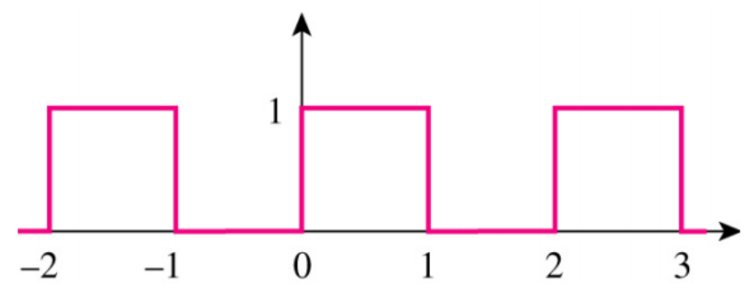
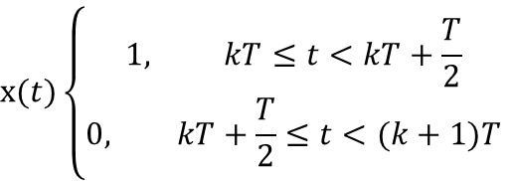
Example:
$$x(t)\left\{\begin{aligned}1, kT≤t<kT+\frac{T}{2} \\ 0, kT+\frac{T}{2}≤t<(k+1)T\end{aligned}\right.$$
X(s)
$$\frac{1}{0.01s+1}$$
Y(s)
y(t)= ?
k=0, 1, 2, …
T=2
x(t)
Since the signal is periodic then we can apply Fourier Series here
t
Fourier Series
If the signal were non-periodic then we would apply Fourier Transform
x(t)
∑sin
t
BLG354E - İTÜ Faculty of Computer Engineering and Informatics - Üstündağ

Slide 26
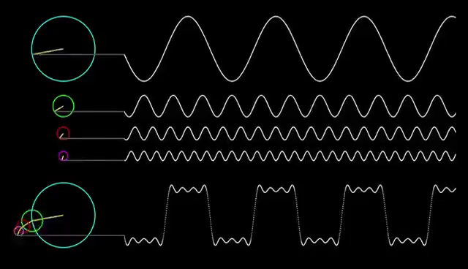
Frequency response of a system if the input is not sinusoidal
Fourier Series: Decomposes periodic signals into sinusoidal harmonics
Fourier Series

